Slide 1

Defensive Security Project
Alfonso, David, Jon, Sophie, & Zoe

Slide 2
Table of Contents
Monitoring Environment
Attack Analysis
Project Summary & Future Mitigations

Slide 3
Monitoring Environment

Slide 4
Scenario
Our team of SOC Analysts received word that JobeCorp, the competitor to Virtual Space Industries (VSI), was going to launch a cyber attack attempting to disrupt the system and applications we run. As employees of VSI and being SOC Analysts, it’s our task to monitor the administrative webpage, Apache web server which hosts the webpage, and our Windows operating system which runs many of VSI’s back-end operations. It’s crucial that we protect VSI’s intellectual property, as Jobe Corp and other competitors may try to steal our ideas for next generation virtual-reality programs. In the past, VSI did not rely on strict policies to protect against attacks, and unfortunately we came to the conclusion that an attack was attempted and carried out. We pulled the logs and discovered a brute force attack from JobeCorp had occurred. After coming to this conclusion and hoping to avoid the same issues in the future, our team of SOC Analysts created tighter alerts and policies within Splunk.

Slide 5
Add-On App:
Website Monitoring

Slide 6
Website Monitoring
An IT Operations app made to detect downtime and performance problems.
In order to protect VSI’s intellectual property, Website Monitoring is an absolute must!

Slide 7
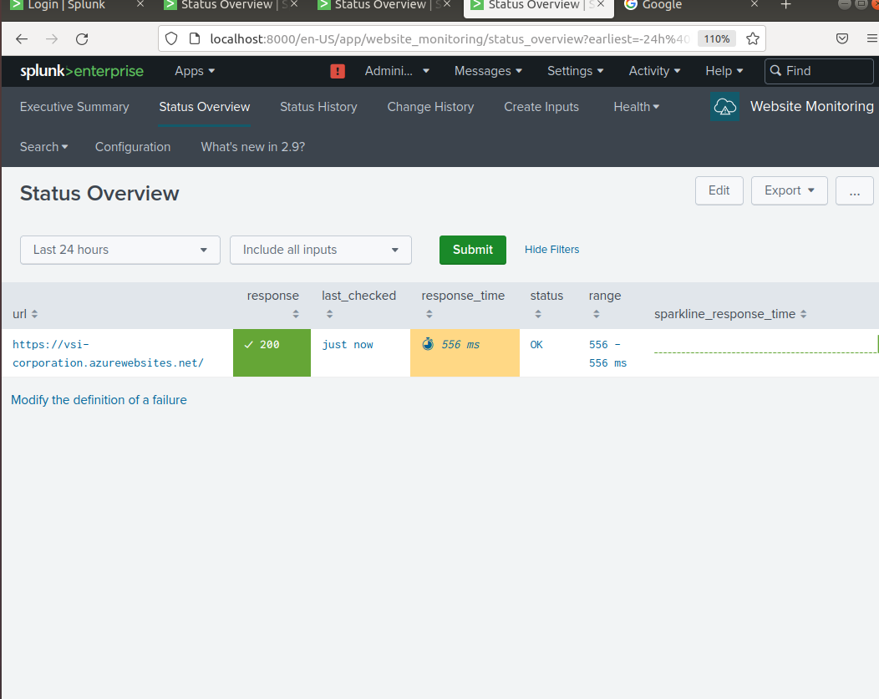
Website Monitoring
We asked the app to verify the site was live every 2 minutes.

Slide 8
Logs Analyzed
Windows Logs
Signature field values over time
User field values
Count of different signatures
Count of different signatures
User stats
Source by user
Apache Logs
Top 10 Geostats
HTTP Methods over Time
ClinetIP Map
Number of URI Paths
Stats count by status
Windows Logs & Apache Logs

Slide 9
Windows Logs
Reports, Alerts, & Dashboards

Slide 10
Reports - Windows
Designed the following reports:
Report Name | Description
Signature/ID Report | Details signatures and their corresponding ID’s along with a count for the current log.
Severity Levels Report | Displays the severity levels along with the count and percentages of each.
Windows Activities Report | Provides a comparison between successful and failed Windows activities.

Slide 11
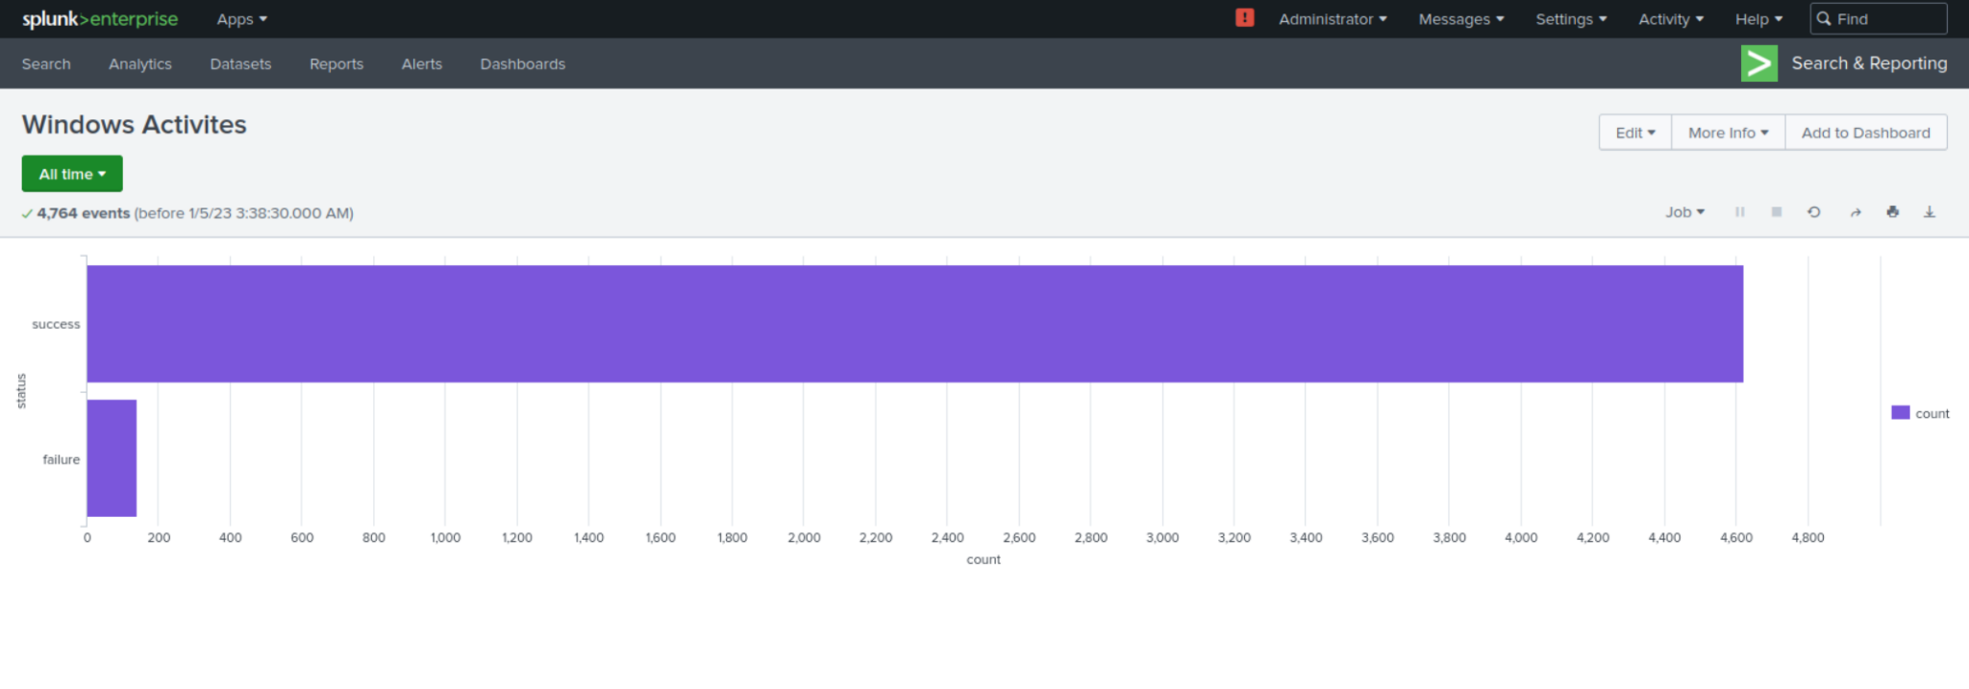
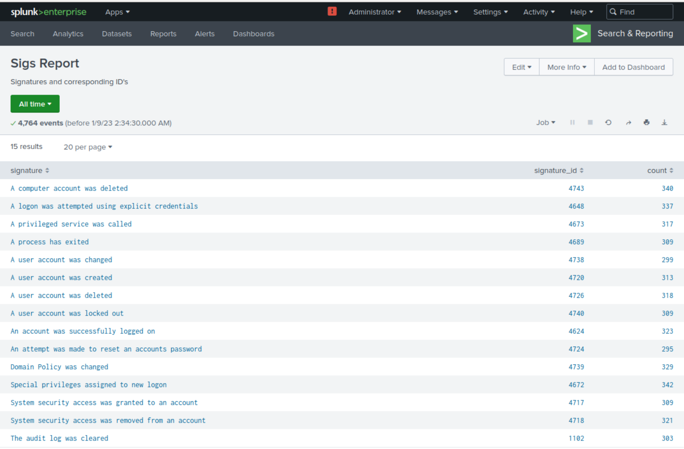
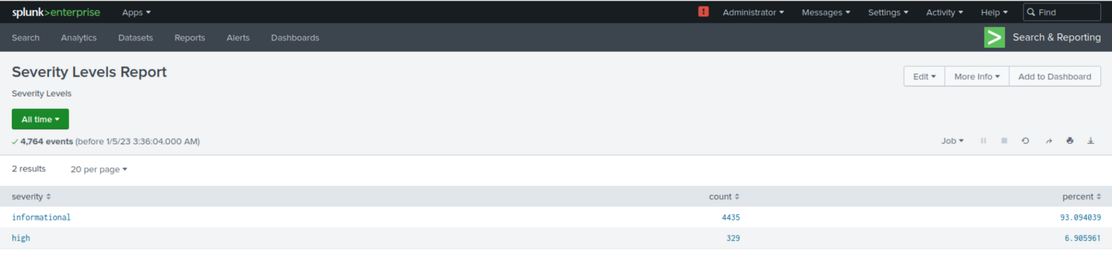
Report Images - Windows

Slide 12
Alerts - Windows
Designed the following Alerts:
Name | Description | Baseline | Threshold
Failed Windows Activity | An alert designed to trigger an email when the designated threshold is reached. | 6 | 7
JUSTIFICATION: We took the average of all the hours in the logs and adding them up and dividing by the number of hours and determined it to be 6. We decided to set the alert at 7, so the alert would be triggered when an above average amount of activity was documented to avoid incessant alerting.

Slide 13
Alerts - Windows
Designed the following Alerts:
Name | Description | Baseline | Threshold
Successful Logon | Alert designed to trigger an email when the houry count of the signature “an account was successfully logged on” reaches a threshold | 13.5 | 15
JUSTIFICATION: The average successful login count was 13.5. We decided to make the threshold 15 to ensure an overwhelming amount of successful logon swerve documents and alerted, but enough leniency is given to where the cyber security staff would not be overwhelmed with successful logins. We viewed this alert as normal.

Slide 14
Alerts - Windows
Designed the following Alerts:
Name | Description | Baseline | Threshold
Deleted Accounts | Alert based on corresponding signature ID designed to trigger an email when threshold is surpassed | 13 | 14
JUSTIFICATION: The average deleted account on the highest volume day was 13. We decided to make the threshold 14. Any amount higher than 14 would be considered abnormal and tigger an email to go check out the situation. We set the priority to normal.

Slide 15
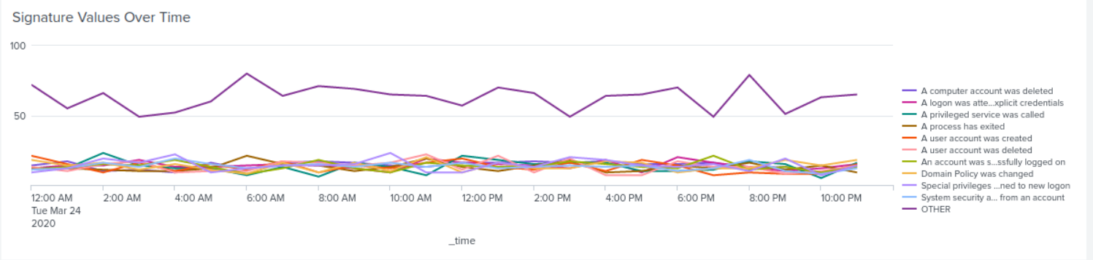
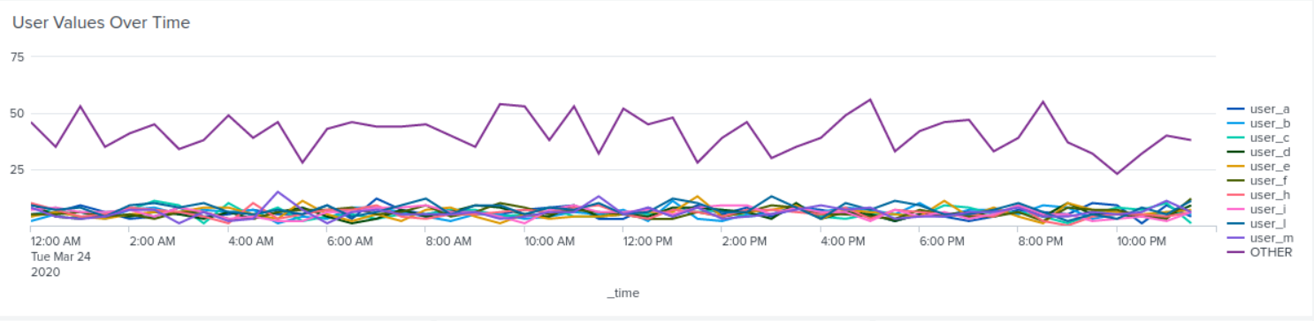
Dashboards - Windows

Slide 16
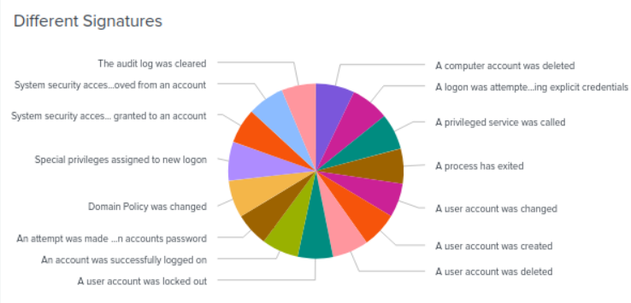
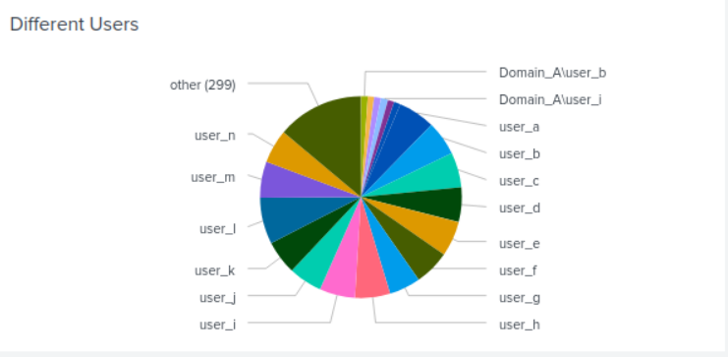
Dashboards - Windows

Slide 17
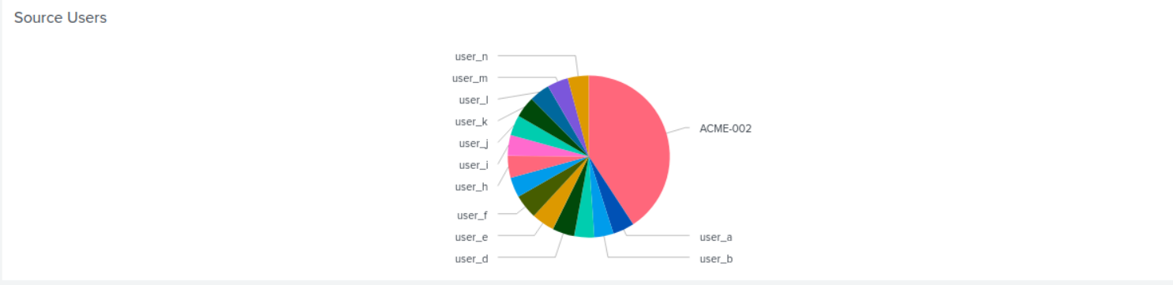
Dashboards - Windows

Slide 18
Apache Logs
Reports, Alerts, & Dashboards

Slide 19
Reports - Apache
Designed the following reports:
Report Name | Description
HTTP Methods Report | Displays a table of the different HTTP Methods (GET, POST, HEAD, OPTIONS).
Top 10 Referrers to VSI Report | Provides the top 10 domains of that refer to the VSI website.
HTTP Response Codes Report | Details each HTTP Response code along with corresponding counts.

Slide 20
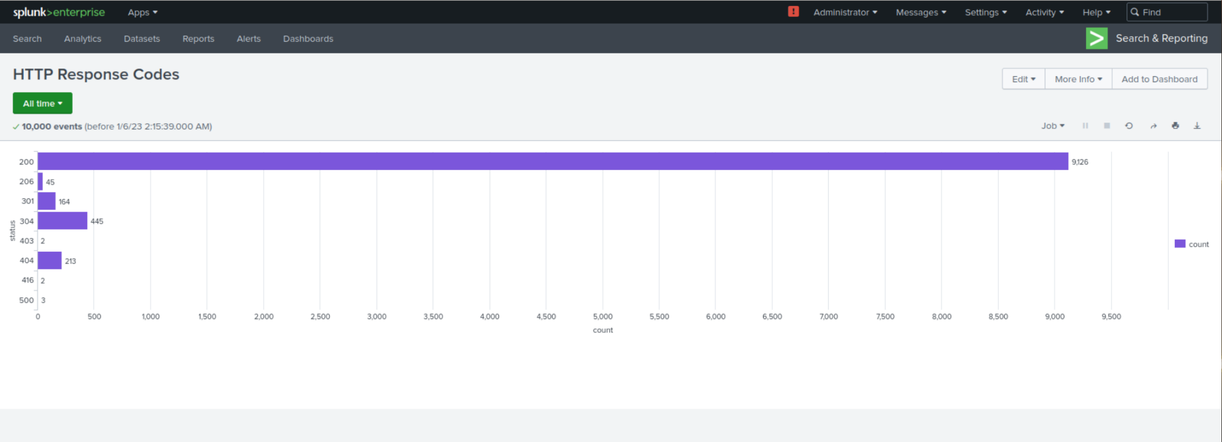
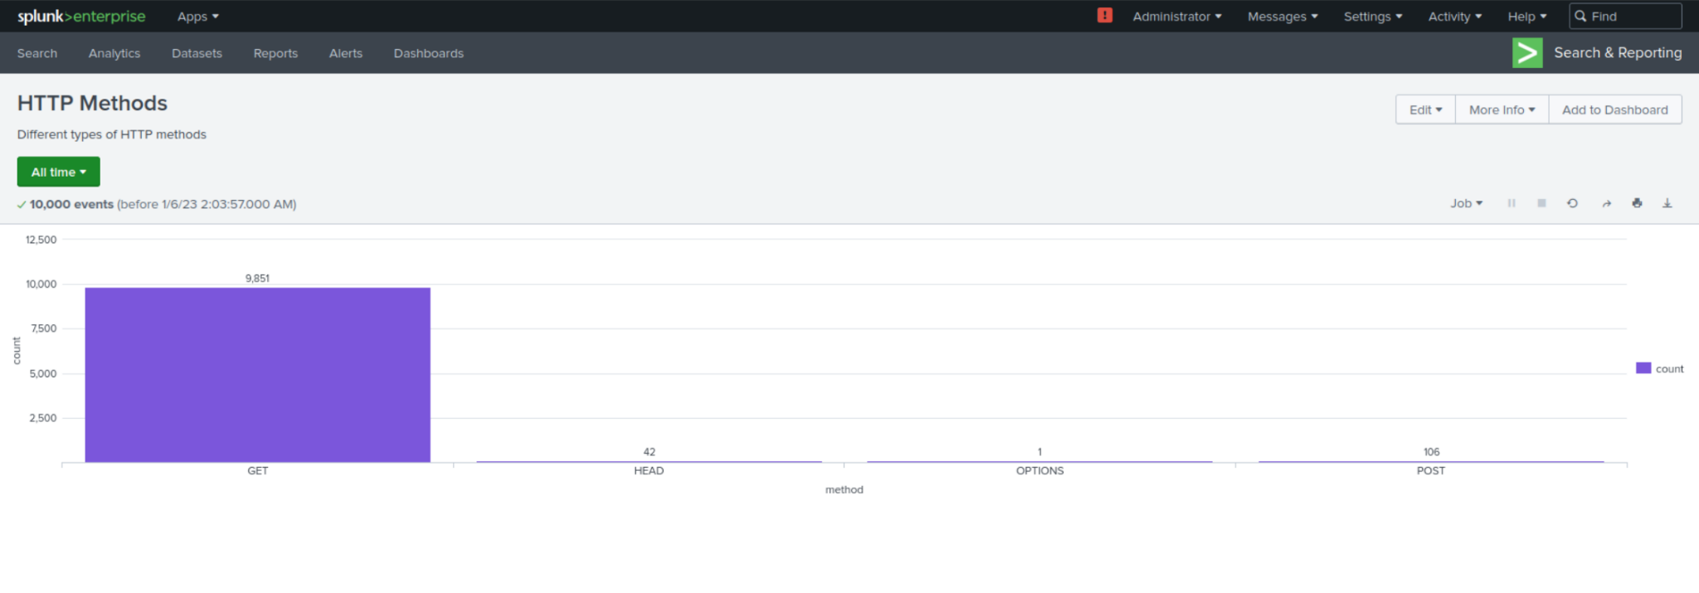
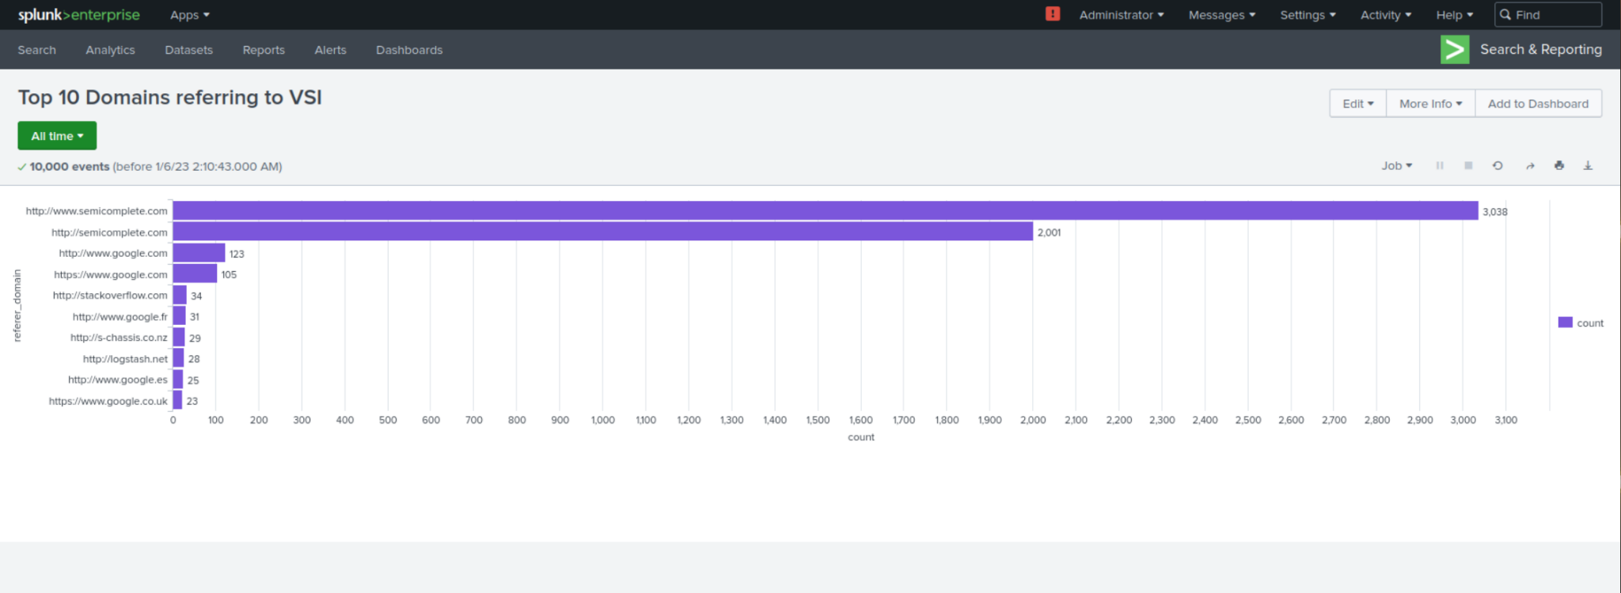
Report Images - Apache

Slide 21
Alerts - Apache
Designed the following Alerts:
Name | Description | Baseline | Threshold
Foreign Activity | Alert designed to trigger when the threshold has been met for hourly activity from any country other than the US | 23 | 25
JUSTIFICATION: The average baseline was 23. We set it to 25 because there seemed to be a sizeable amount of traffic from foreign places, which should be allowed without triggering, however, anything above 25 is seen as excessive and will trigger an alert immediately.

Slide 22
Alerts - Apache
Designed the following Alerts:
Name | Description | Baseline | Threshold
HTTP Post Method Baseline | Alert created to trigger an email when the threshold of hourly count of the HTTP POST method | 1.5 | 2
JUSTIFICATION: The average activity was 1.5. We set it at 2 to make sure anything above is alerted.

Slide 23
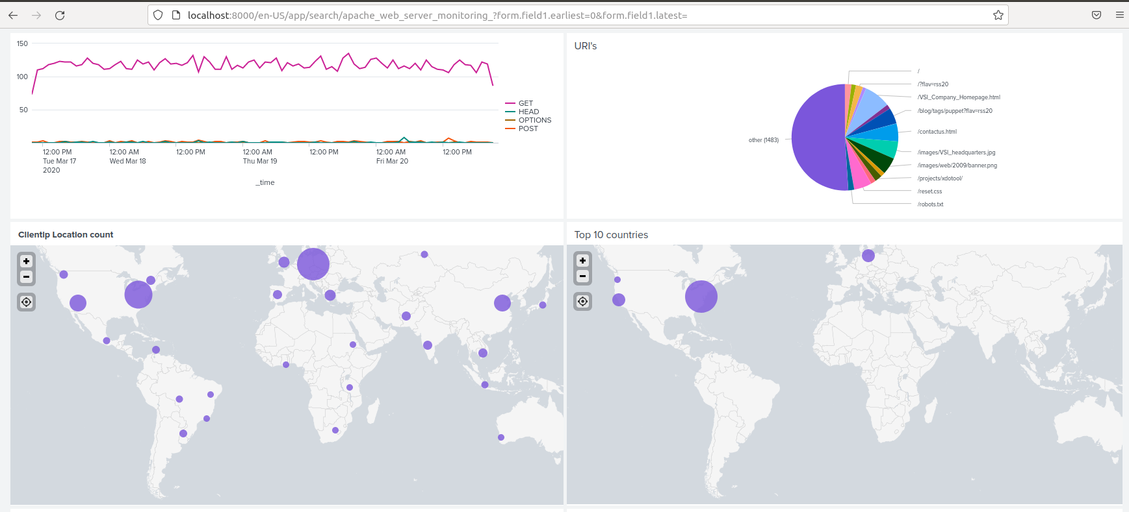
Dashboards - Apache

Slide 24
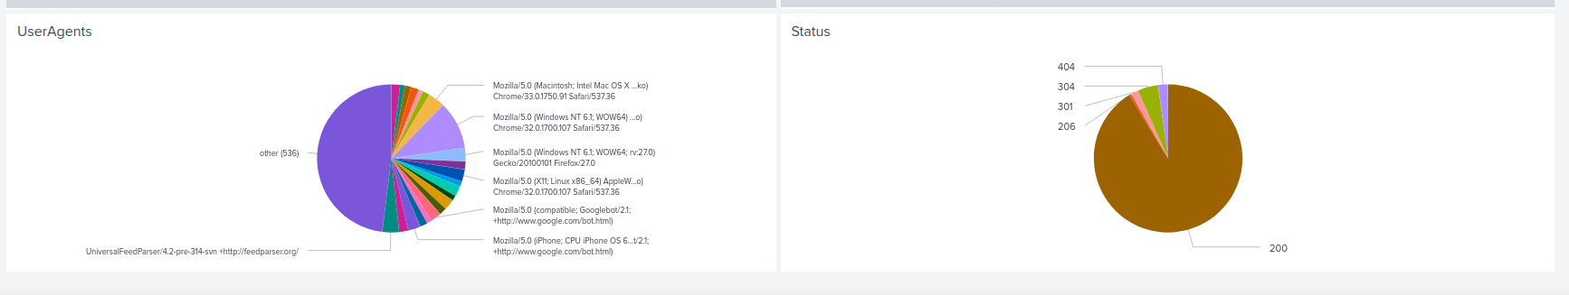
Dashboards - Apache

Slide 25
2. Attack Analysis

Slide 26
Attack Summary - Windows Reports
Initially, we noticed a change in high severity activities which showed an increase of 15%. When diggin deeper into the activities, there was a volume of 35 events at 8am on Wednesday, March 25th, 2020.

Slide 27
Attack Summary - Windows Alerts
Our alerts indicated that there was a suspiciously high volume increase in log on attempts. We saw 16 events in one hour, with the primary user being “User_C”. This increase occurred at 8am on March 25th, 2020. We also noticed a vast increase in deleted accounts; 17 in total at 5am on Wednesday, March 25th, 2020.

Slide 28
Attack Summary - Windows Dashboards
Multiple signatures stood out as suspicious on the VSI Windows Server Dashboard. The time windows for each are: - From 12am to 3am on March 25th, 2020, user accounts were being locked out. The peak number of accounts being locked out hit 896. - From 8am to 11am on March 25th, 2020, account passwords were being reset. The peak number of passwords being reset was a staggering 1,258. - From 10am to 1pm on March 25th, 2020, many accounts were successfully logging in. The peak number of successful log ins totaled 196. It’s highly worth noting that User A, User K, and User J were the 3 main accounts to hit suspiciously high volumes. User A’s activity peaked at 745 events between the hours of 1:40am to 2:50am. User K’s activity peaked at 397 between the hours of 9am to 11am, and User J’s activity peaked at 35 between the hours of 10:45am and 12:30pm. User A and User K were the main focus of our investigation, however we deemed User J’s numbers were suspicious in comparison to normal activity from other users.

Slide 29
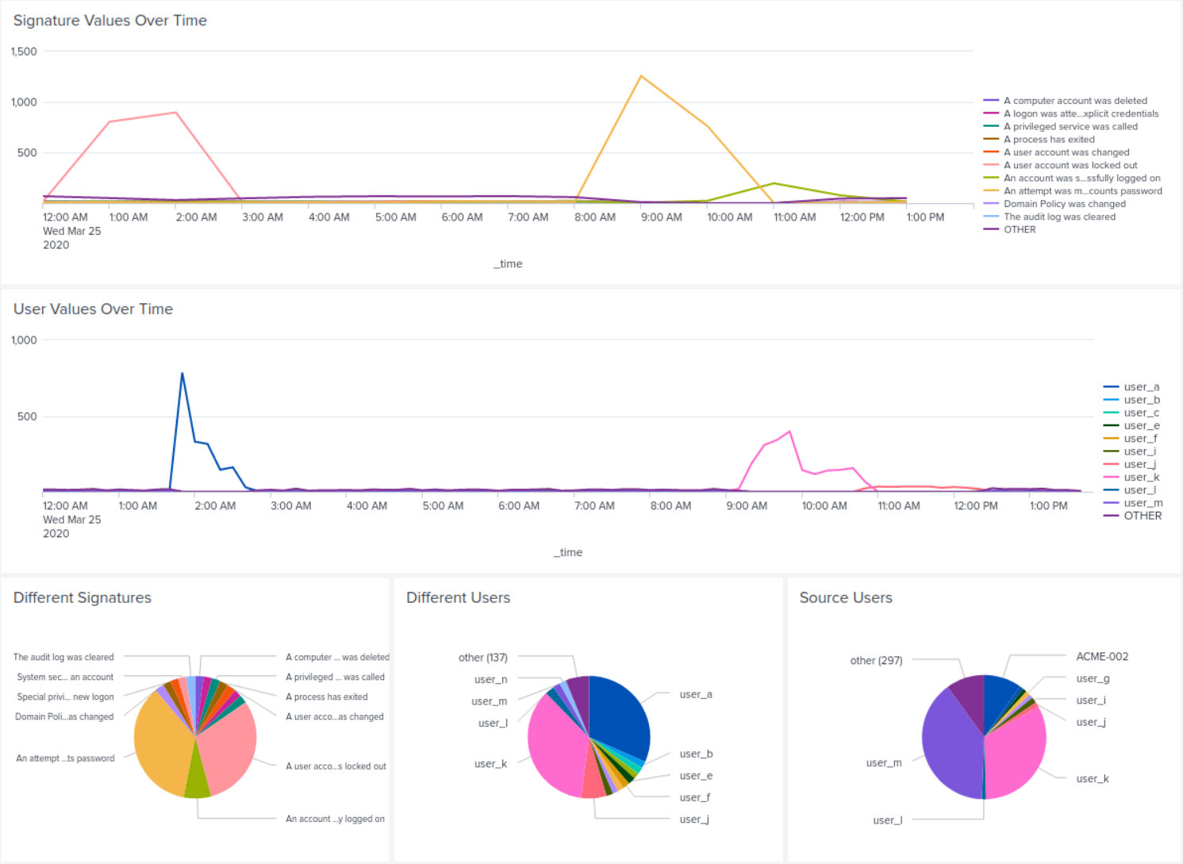
Windows Attack Log Images

Slide 30
Attack Summary - Apache Reports
On March 25th , 2020 at 8pm, our security team found that there was a brute force attempt made on the VSI login page.
What the team found was a large fluctuation in POST, GET, 404 response code, and the referred domains.
With the drastic increase in POST 404 response, we have proof the attacker was attempting multiple times to use users that could have been acquired via social engineering, and brute forcing the VSI login page.

Slide 31
Attack Summary - Apache Alerts
Based on the previous slide, with the high number of POST and response code 404, our security team also received an alert for high international activity.
In addition to the alerts for large international connections, we have also made an alert for any failed login attempts.
This ensures that we are aware of any users that have too many failed attempts.

Slide 32
Attack Summary - Apache Dashboards
Our Apache Dashboard was created to show GET and POST data across the world with time stamps included. There was a high increase in GET from 5pm to 7m, and a high increase in POST from 7pm to 9pm. The peak number for GET hit 729 during the two hour time window, and POST hit a whopping 1,296 in the same 2 hour time window. The URI that was hit the most was /VSI_Account_logon.php, which is VSI’s log in page. This indicated there was a brute force attack.

Slide 33
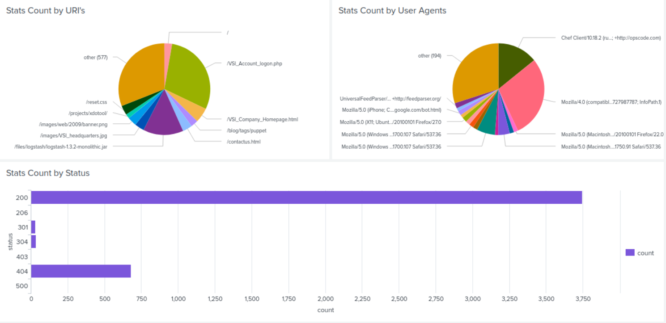
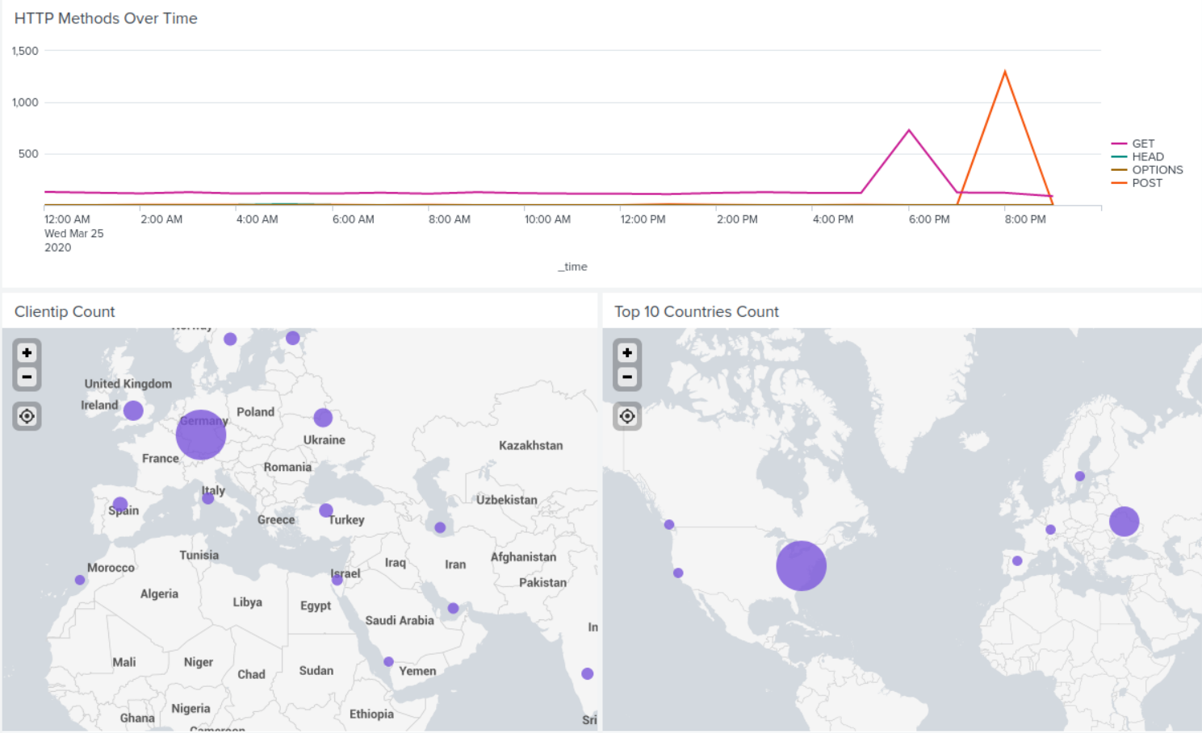
Apache Attack Log Images

Slide 34
3. Summary & Future Mitigations

Slide 35
Summary
After thoroughly combing through VSI’s Window Logs and the Apache Web Server Logs, we determined that JobeCorp carried out a Brute Force Attack on the log in page for VSI. The attack began at 8am on March 25th, 2020, and lasted until 9pm the same day. Two user accounts, User A and User K, were the main accounts that were spammed in order to shut down the Web Server and cause users to reach a 404 error code on the log in page.

Slide 36
Future Mitigations
Keeping in mind that VSI’s cutting edge virtual-reality programs for businesses are the core focus of the company, it’s essential that we protect against any and all future attacks to the best of our abilities as SOC Analysts. After implementing an entirely new alert system that syncs to new dashboards, as well as establishing new baselines, we feel confident that future attacks won’t be successful. We will also be working towards creating new policies for multiple failed log in attempts, such as locking out an account after 10 failed attempts. VSI also feels confident that enabling a 2 way authenticator will help mitigate any future brute force attacks. Employees will be required to connect their phone number to the authenticator to further strengthen our securities.

Slide 37
Questions?

